Slide 1
Menzies School of Health Research
CA Youth Type 2 Diabetes Prevention A consultation project

Slide 2
Acknowledgement of country
We acknowledge the Arrernte people, the traditional custodians of the land on which we meet.
We pay our respect to the Elders past, present and emerging and all the Aboriginal and Torres Strait Islander people who are present here today.
CA ASHN Research Showcase – October 8, 2020

Slide 3
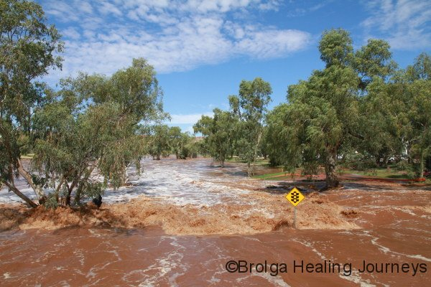
Background
Identified need to address emerging rates of youth onset obesity and diabetes in children and young people in Central Australia.
This project was developed in response to requests from NT communities and clinicians, including:
Indigenous Reference Group
Clinical Reference Group
NT Youth Diabetes Working Group
CA ASHN Research Showcase – October 8, 2020

Slide 4
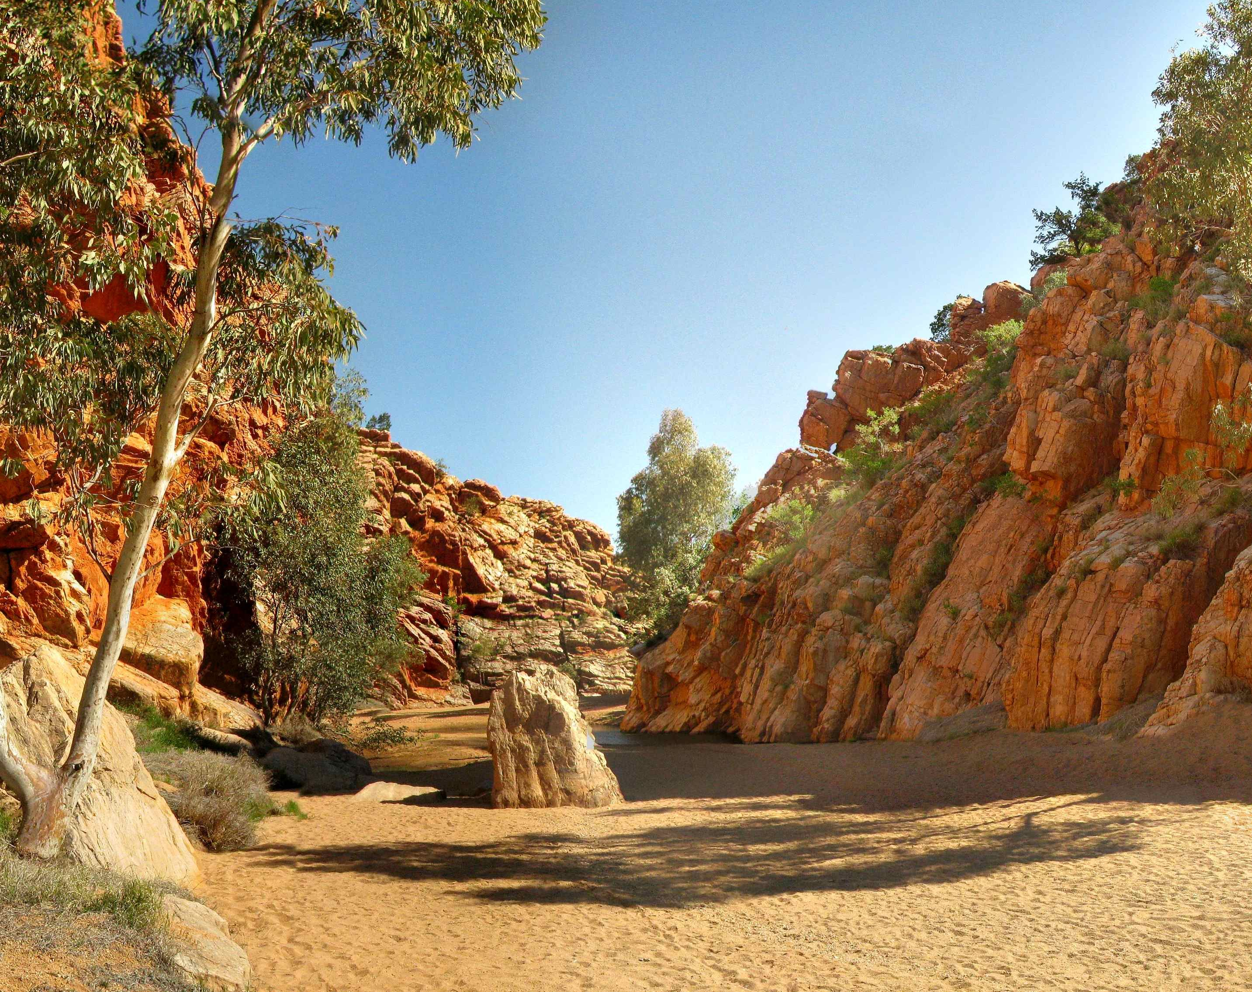
Our project had two aims………
AIM 1
To understand the needs and experiences of Aboriginal and Torres Strait Islander children and youth with type 2 diabetes.
Ethics Approval reference – CA 18-3055
AIM 2
To adapt a behavioural intervention program to improve cardio-metabolic risk of 6-11 year old in Central Australia.
Ethics Approval reference – CA 19-3343
CA ASHN Research Showcase – October 8, 2020

Slide 5
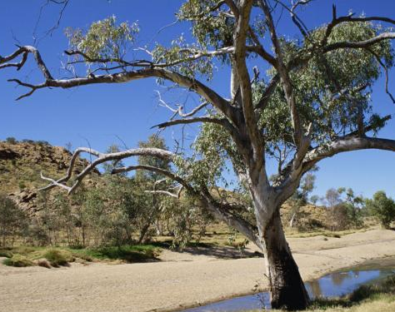
AIM 1 – Brief update
Aboriginal and Torres Strait Islander youth (10-25 years) with type 2 diabetes were interviewed in two Central Australian sites.
Key findings
Diabetes affects young people’s identity
Shame contributes to feelings of isolation and disengagement with services
Young people often have many competing priorities
including co-morbidities, caring responsibilities
Creating a youth friendly diabetes clinic is having a positive impact on engagement with health services.
CA ASHN Research Showcase – October 8, 2020

Slide 6
AIM 2 – Youth onset obesity & diabetes prevention
Develop a culturally-appropriate and family-focused diabetes prevention program
Targets Aboriginal children (6-11 years) & their families
Adapting the Tribal Turning Point (TTP) program
- A North American First Nation communities youth diabetes prevention program
CA ASHN Research Showcase – October 8, 2020

Slide 7
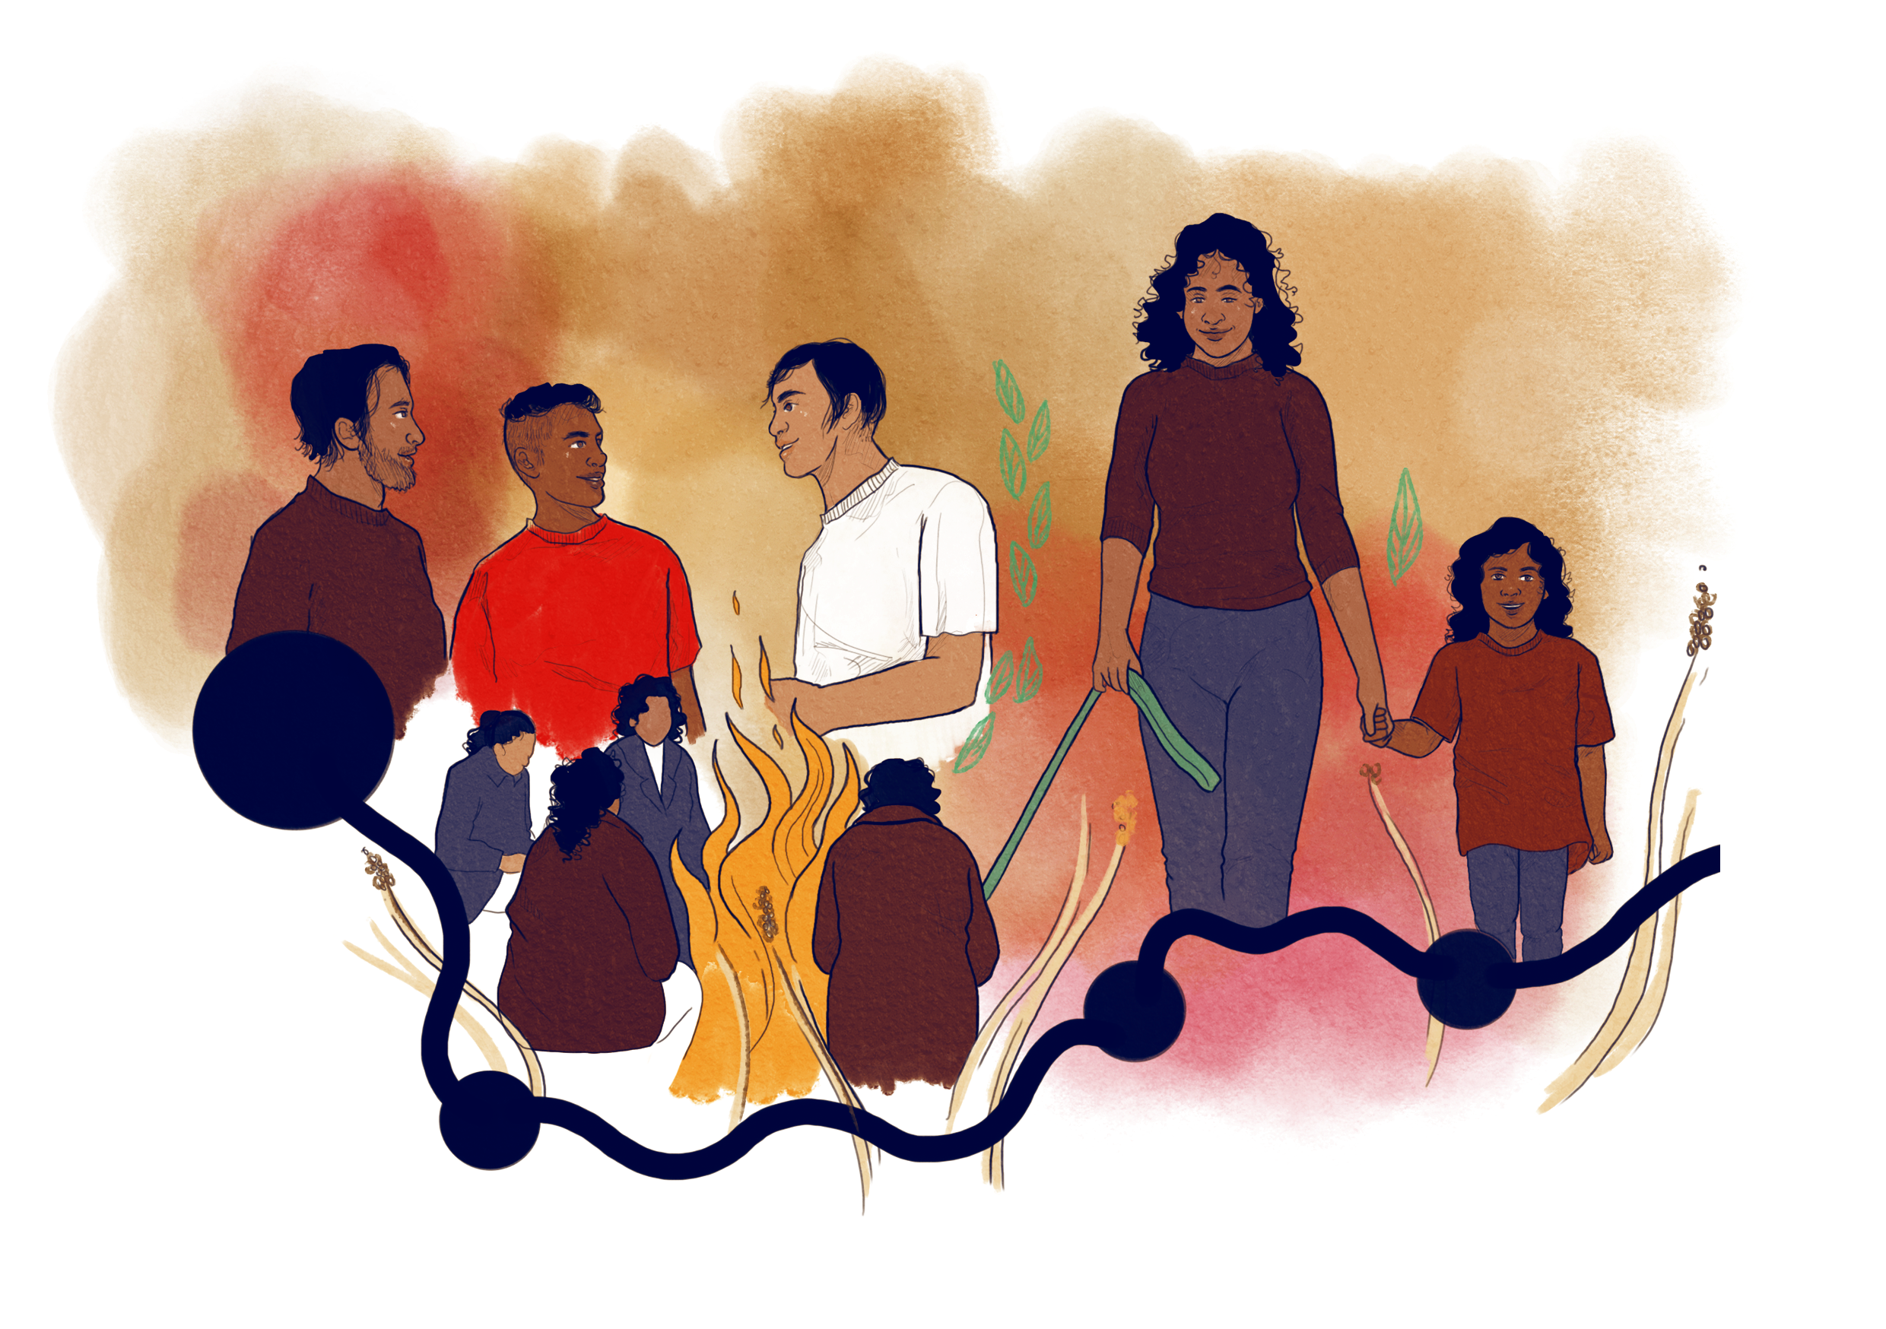
Project components………
A formative consultation work
1. Community consultation
2. Revision of the program manual
Multiple advisory groups support this project
Dietitian working group
Nutrition & diabetes related content expertise
Technical reference group
Oversees the consultation process & program revision
Cultural reference group
To ensure local cultural and language needs
CA ASHN Research Showcase – October 8, 2020

Slide 8
Expected outcomes ………
Inform the adaptation of the Tribal Turning Point to the local context and ensure it aligns with local needs, priorities and cultures.
Inform larger grant application/s to implement a pilot trial of a lifestyle intervention program to improve cardiometabolic health of Aboriginal youth aged 6-11 years.
CA ASHN Research Showcase – October 8, 2020

Slide 9
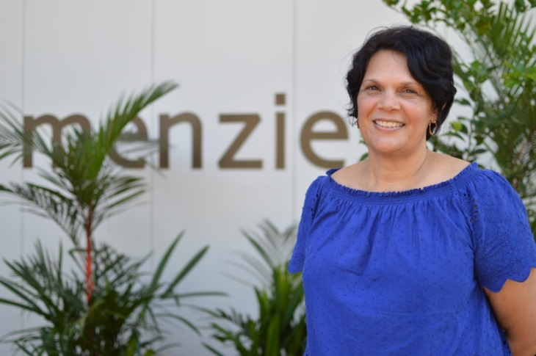
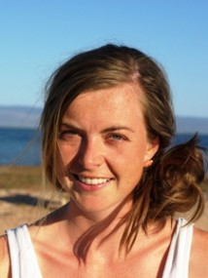
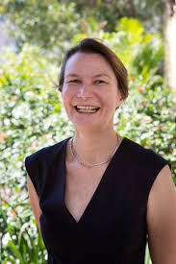
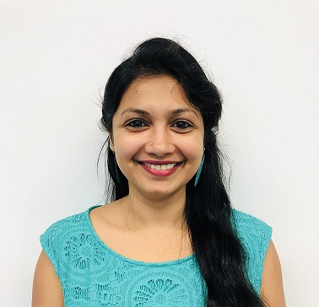
Our Team
Co-investigators
Dr John Boffa - Central Australian Aboriginal Congress, Alice Springs
Ms. Kathy Coulthard - Central Australian Health Service, Alice Springs
Dr James Dowler - Central Australian Health Service, Alice Springs
Dr Christine Connors – Top End Health Service, Darwin
Dr Elizabeth Moore - Aboriginal Medical Services Alliance Northern Territory, Darwin
Ms. Sian Graham - Menzies School of Health Research, Darwin
Dr Angela Titmuss - Menzies School of Health Research, Darwin
A/Prof Federica Barzi - Menzies School of Health Research, Darwin
Prof Alex Brown - South Australian Health and Medical Research Institute, Adelaide
Prof Louise Baur - University of Sydney
Dr Karla Canuto - South Australian Health and Medical Research Institute, Adelaide
Dr Leisa McCarthy
Lead Investigator
Alice Springs
Dr Renae Kirkham
Lead Investigator
Darwin
Prof Louise Maple-Brown
Principal Investigator
Darwin
Ms. Shiree Mack
Research Officer
Alice Springs
Dr Athira Rohit
Senior Research officer/Project Manager
Darwin
CA ASHN Research Showcase – October 8, 2020

Slide 10
Community consultations
14 workshops
Service providers, cultural advisors, and parent groups (Jul 2019 – Feb 2020)
Appropriateness, acceptability, content and logistics
Data analysis completed
CA ASHN Research Showcase – October 8, 2020

Slide 11
“Program needs to come from more of a holistic approach rather than a deficit model.”
(Cultural advisor)
“It’s a good program for people that want to make changes or are already making changes.”
(Parent)
“Like I said before this [program] is very important for our children. We want them to be happy, to live happy, healthy lives.”
(Cultural advisor)
Consultation findings
“I think people would engage more if they related to the person. So, definitely a local person [for facilitation].” (Parent)
Be flexible, [program] must be flexible if you're working with a family… I think more hands-on stuff rather than sitting down and talking.” (Community engagement officer)
“Let the community decide if they need all 10 sessions or fewer sessions.” (Dietitian)
CA ASHN Research Showcase – October 8, 2020

Slide 12
A strong need for the proposed youth diabetes and obesity prevention program.
The program needs to be community owned and led.
Community members need to be trained as facilitators for program delivery.
Program needs to be flexible to accommodate community priorities.
Program manual needs to be reviewed to adapt to the Central Australian context.
There needs to be a sound evaluation plan prior to piloting the program.
Key consultation findings………
CA ASHN Research Showcase – October 8, 2020

Slide 13
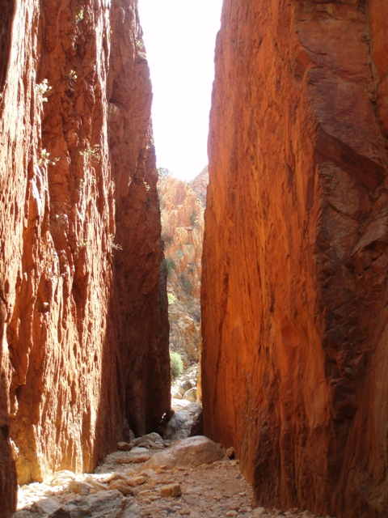
Program Revision
Preliminary revision by the Dietitians Working Group (Dec 2019)
Cultural advisor review (Feb – Mar 2020)
Detailed revision by the Dietitians Working Group (May – Jul 2020)
Cultural reference group review is underway
Anticipated to be complete by end Oct 2020
CA ASHN Research Showcase – October 8, 2020

Slide 14
1. Welcome session | Introduction to the program, facilitators and families Food groups
2. Traditional Foods, Traditional Lifestyle and Whole Foods | Knowledge of traditional bush foods Traditional food practices and lifestyles
3. Choosing Healthy Foods | Understanding the nutritional value of different foods
4. Mindful Eating & Self-compassion | Self-care awareness Mindful eating techniques Stress management skills
5. Joyful Movements | Physical activity, exercising safely Access to fitness resources in the community
6. Balancing Your Plate | Balanced meal Food groups
7. Healthy Environment | Role modelling at home Ways to create healthy food environment
8. Eating out | Healthier choices when eating away from home
9. Stress management | Positive and negative thoughts Managing slips from healthy eating and physical activity
10. Ways to stay motivated | Revision of topics covered Families can choose particular topics
Key revisions……
Families proposed names for the program (Arrernte and English)
Families Eat well and Stay strong Artweyenhenge arlkweme Merne Marda
Eating Good food
Merne mwarre arlkweme
Healthy Heart and Soul ayerte-ayerte urtakwerte atnerte
Revised session order
Sensitive sessions to be delivered as appropriate
CA ASHN Research Showcase – October 8, 2020

Slide 15
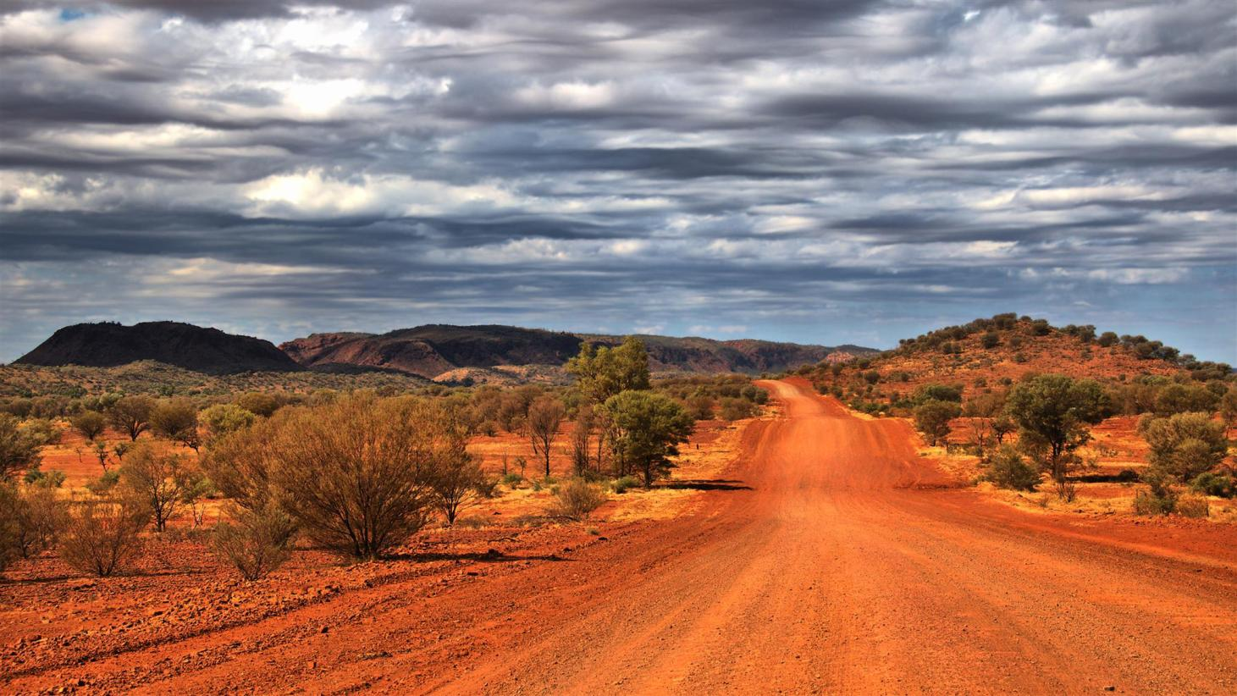
What next?
Local ACCHO (such as Congress) to lead future funding application with us providing research support
Acquire funding for a pilot trial of the adapted program
Publish the adapted program manual
CA ASHN Research Showcase – October 8, 2020

Slide 16
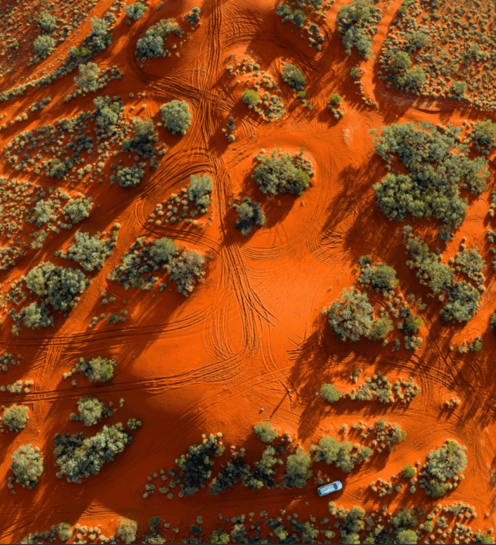
Thank you!
Families and service providers who participated in the consultation
Funders –
Central Australia Academic Health Science Network
Partners –
Central Australian Aboriginal Congress
Central Australian Health Service
Investigators

